Slide 1
Managing The Information Systems Project
Focus of Project Management
To assure that information system projects meet customer expectations
Delivered in a timely manner
Meet constraints and requirements
PM's Motto:
Highly quality deliverables, on time, on budget

Slide 2
Contd..
Project Manager
-Requires diverse set of skilss
Planning
Organizing
Monitor and Control
Leadership
Customer relations
Technical problem solving
Conflict management
Communications
Risk management
Change management

Slide 3
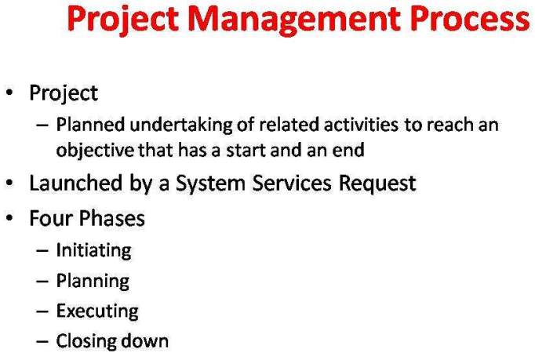

Slide 4
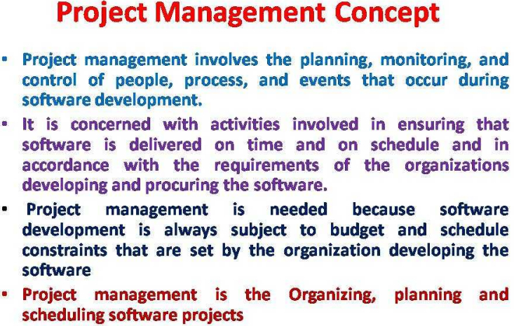

Slide 5
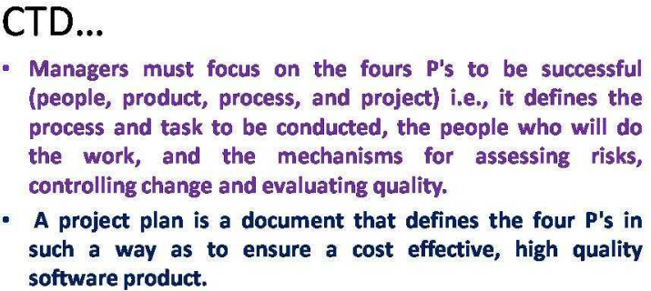

Slide 6
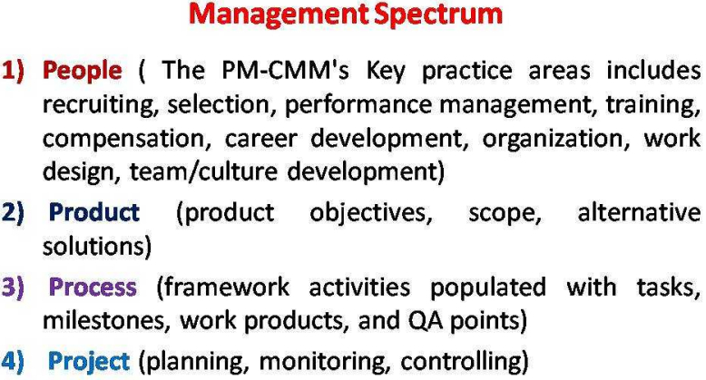

Slide 7
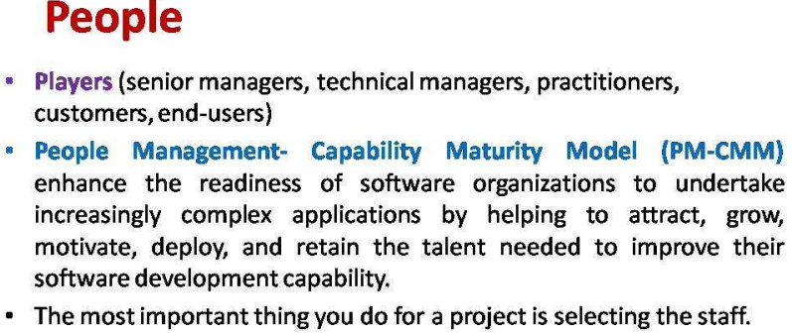

Slide 8
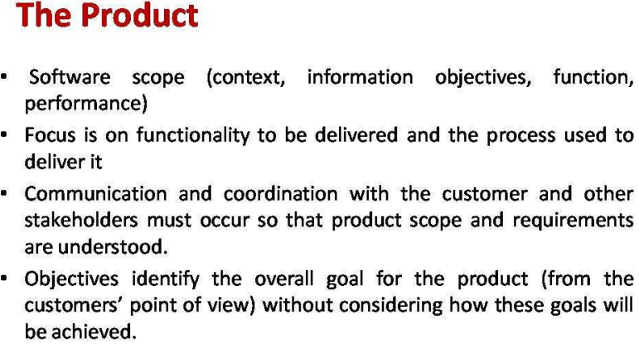

Slide 9
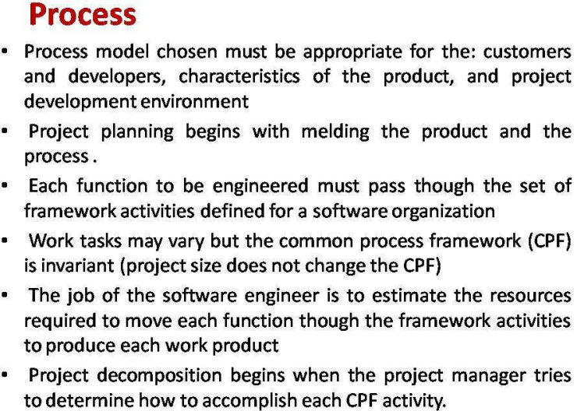

Slide 10
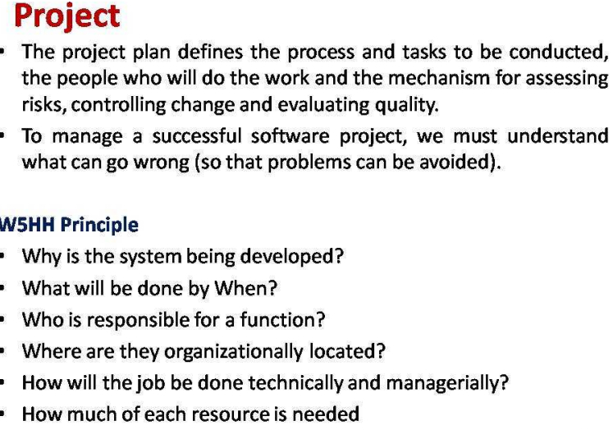

Slide 11
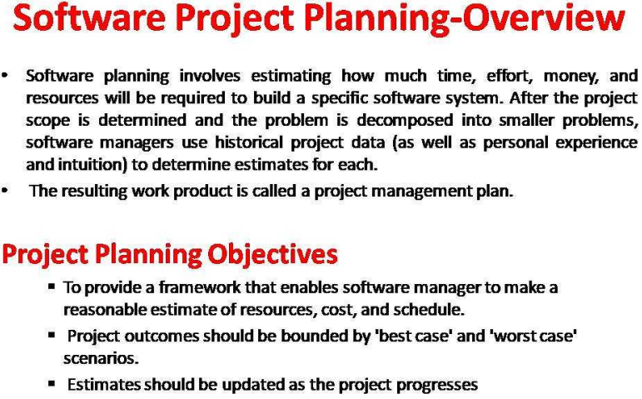

Slide 12
Types Of Project Plan
Plan | Description
Quality Plan | Describes the quality procedures and standards that will be used in a project
Validation Plan | Describes the approach, resources and schedules used for system validation
Confirmation management plan | Describes the configuration management procedures and structures and structures to be used
Maintenance plan | Predicts the maintenance requirements of the system, maintenance cost, and effort required
Staff development plan | Describes how the skills and experience of the project team members will be developed

Slide 13
Software Project Planning Activities
Step 1: Determination of software scope and feasibility study
Step 2: Estimation of the resources

Slide 14
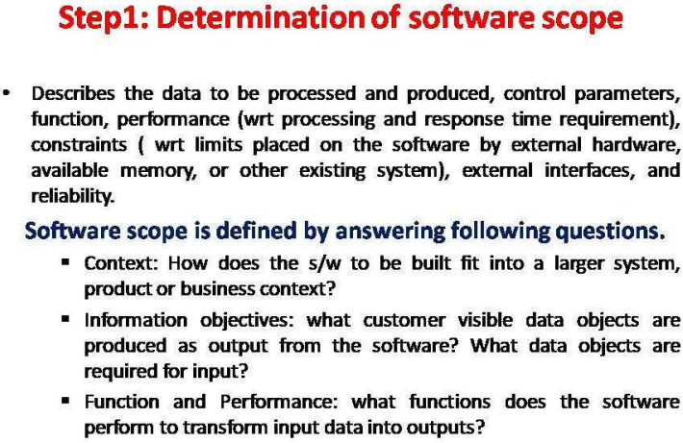

Slide 15
Customer Communication and Scope
Necessary information is obtained by conducting a preliminary meeting or interview with customers, where analyst prepare a set of context free questions in order to
Determine the customer's overall goals for the proposed system and any expected benefits.
Evaluate the effectiveness of the customer meeting
FAST(Facilitated Application Specification Techniques)
It is a team-oriented approach to requirement gathering that can be applied to help establish the scope of a project.
It encourages the creation of a joint team of customer and development who work together to identify the problem, propose elements of the solution, negotiate different approaches and specify a preliminary set of requirements

Slide 16
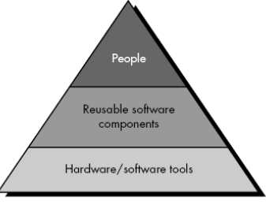
Step 2: Estimation Of Resources
Human Resources (number of people required and skills needed to complete the development project)
Reusable software resources (off-the-shelf components, full-experience components, new components)
Development environment(hardware and software required to be accessible by software team during the development process)

Slide 17
Project Scheduling
Software project scheduling is an activity that distributes estimated effort across the planned project duration by allocating the effort to specific software engineering tasks.
Split project into tasks and estimate time and resources required to complete each task.
Organize tasks concurrently to make optimal use of workforce.
Minimize task dependencies to avoid delays caused by one task waiting for another to complete

Slide 18
Things done before project scheduling
Selection of an appropriate process model
Identification of the software engineering tasks
Estimation of work size, people
Calculation of deadline
Risk analysis
Things to do during scheduling
Creation of activity network (Effort and duration allocated to each task and a task network)
Assign responsibility for each task

Slide 19
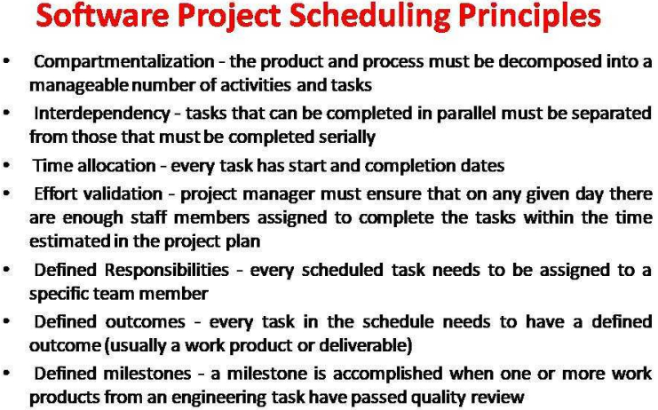

Slide 20
Project Scheduling Process

Slide 21
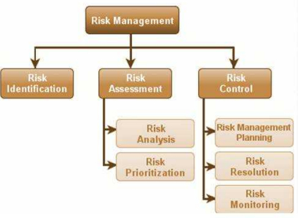
Risk Management
Risk management is a methodology or a mechanism, carried out throughout the development process to identify, manage and control risks evolved before and during the development process.
Risk management is concerned with identifying risks and drawing up plans to minimise their effect on a project.
Basically, three types of activities are covered under the risk management process
Risk Identification
Risk Assessment
Risk Control

Slide 22
Contd…
Risk identification
Identify project, product and business risks;
Risk analysis
Assess the likelihood and consequences of these risks;
Risk planning
Draw up plans to avoid or minimise the effects of the risk;
Risk monitoring
Monitor the risks throughout the project;

Slide 23
Contd..

Slide 24
Risk Identification
Technology risks.
People risks.
Organisational risks.
Tool risks.
Requirements risks.
Estimation risks.

Slide 25
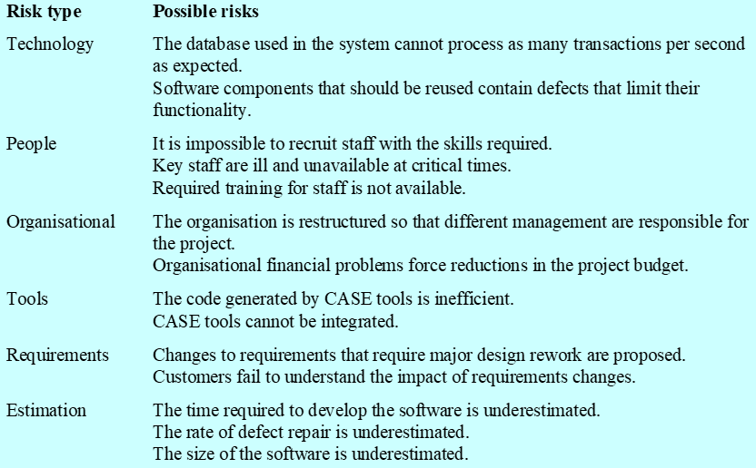
Risks and risk types

Slide 26
Risk analysis
Assess probability and seriousness of each risk.
Probability may be very low, low, moderate, high or very high.
Risk effects might be catastrophic, serious, tolerable or insignificant.
Risk planning
Consider each risk and develop a strategy to manage that risk.
Avoidance strategies
The probability that the risk will arise is reduced;
Minimisation strategies
The impact of the risk on the project or product will be reduced;
Contingency plans
If the risk arises, contingency plans are plans to deal with that risk;

Slide 27
Risk Monitoring
Assess each identified risks regularly to decide whether or not it is becoming less or more probable.
Also assess whether the effects of the risk have changed.
Each key risk should be discussed at management progress meetings.

Slide 28
Software Cost Estimation
Predicting the cost of resources required for a software development process
To introduce the fundamentals of software costing and pricing
To explain software productivity metric
To explain why different techniques for software estimation:
LOC
Function point model
Object point model
COCOMO (Constructive Cost Model)
UCP: Use Case Points

Slide 29
Why Early Cost Estimation?
Cost estimation is needed early for s/w pricing
S/W price = cost + profit

Slide 30
Fundamental Estimation Questions
Effort
How much effort is required to complete an activity
Units: man-day(Person-day), man-week, man-month
Duration
How much time is needed to complete an activity? Resources assigned
Units: hour, day, week, month, year
Cost of an activity
What is the total cost of an activity

Slide 31
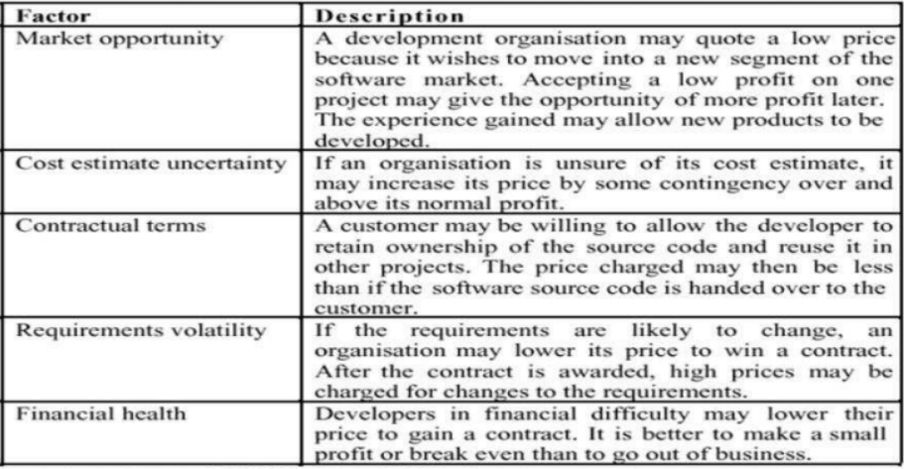
Factor affecting software pricing

Slide 32
Productivity Measures
S/W productivity measured are based on:
Size related measures:
Based on some output from the software process
Number lines of delivered source code(LOC)
Function-related measures
based on an estimate of the functionality of the delivered software
Function-points(are the best known of this type of measure)
-Based on combination of program characteristics(external inputs and outputs, user interactions, external interfaces and files used by the system)
Object-points: number of object points in program is a weighted estimate of
The number of separate screens, reports and modules

Slide 33
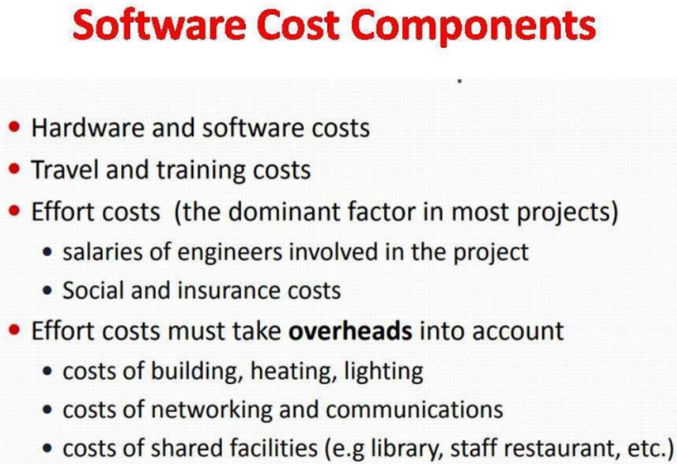

Slide 34
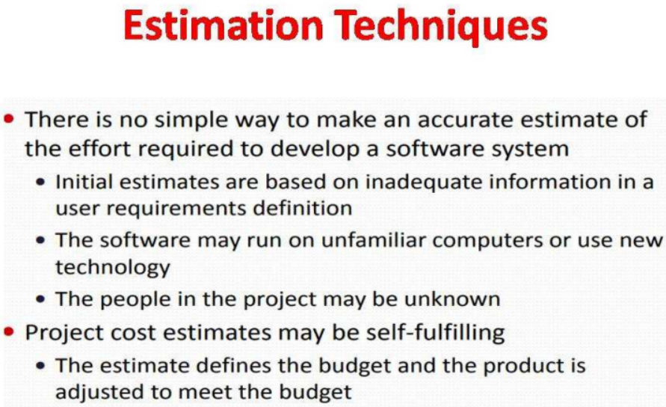

Slide 35
Estimation Techniques
Algorithmic cost modeling
Expert judgement
Estimation by analogy
Parkinson’s law
Pricing to win

Slide 36
Algorithmic code modelling
A formula – empirical relation:
Based on historical cost information and which is generally based on the size of the software
The formulae used in a formal model arise from the analysis of historical data
Expert Judgement
One or more experts in both software development and the application domain use their experience to predict software costs. Process iterates until some consensus is reached
Advantages: Relatively cheap estimation method. Can be accurate if experts have direct experience of similar systems.
Disadvantages: Very inaccurate if there are no experts

Slide 37
Estimation By Analogy
Experience-based estimates
The cost of a project is computed by comparing the project to a similar project in the same application domain
Advantages: Accurate if project data available
Disadvantages: Impossible if no comparable project has been tackled. Needs systematically maintained cost database.

Slide 38
Parkinson’s Law
The project costs whatever resources are available(Resources are defined by the software house)
Disadvantages: System is usually unfinished
The work is contracted to fit the budget available: by reducing functionality, quality
Parkinson’ law states that work expands to fill the time available. The cost is determined by available resources rather than by objective statement.
Example: Project should be delivered in 12 months and 5 people are available. Effort=60 p/m

Slide 39
Pricing To Win
This approach may seem unethical and un-businesslike.
However, when detailed information is lacking it may be the only appropriate strategy.
The project cost is agreed on the basis of an outline proposal and the development is constrained by that cost.
A detailed specification may be negotiated or an evolutionary approach used for system development.

Slide 40
COCOMO(COnstructive COst MOdel)
The COCOMO is an algorithmic software cost estimation model developed by Barry Boehm. The model uses a basic regression formula, with parameters that are derived from historical project data and current project characteristics
COCOMO consists of a hierarchy of three increasingly detailed and accurate forms.
The first level, Basic COCOMO is good for quick, early, rough order of magnitude estimates of software costs, but its accuracy is limited due to its lack of factors to account for difference in project attributes (Cost Drivers).
Intermediate COCOMO takes these Cost Drivers into account and Detailed COCOMO additionally accounts for the influence of individual project phases

Slide 41
COCOMO Applies To Three Classes Of Software Projects:
Organic projects - "small" teams with "good" experience working with "less than rigid" requirements
Semi-detached projects - "medium" teams with mixed experience working with a mix of rigid and less than rigid requirements
Embedded projects - developed within a set of "tight" constraints (hardware, software, operational)

Slide 42
Unit 8 (Managing Software Product): Assignment
What are the skills necessary to handle software project? Explain different software projects management activities
What is estimation technique. Explain about types of estimation technique.
What are the factors affecting software pricing? Explain
What is project scheduling. Explain its principles.
Define software project planning and types of project plan. Explain its Software project planning activities
What is risk management? Explain risk management process in software engineering with block diagram.

